Slide 1


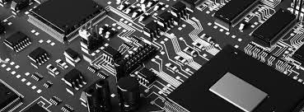

SMART HELMET
Project Members:
1.Chinmay Kulkarni - 19151265
2.Pratiksha Thorat - 19151167
3.Komal Suryawanshi -19151154
Guided by:
Prof. Ashwini Shinde

Slide 2

Abstract
Introduction
Flow Chart
Components used
Contents
Experimental Setup
Working Principle
Advantages
Applications
Conclusion
Future Scope

Slide 3


Abstract
Every day an average of 1214 road accidents occur in India. Out of these, 25% of these accidents are caused by two wheelers.
An effective solution to this problem is to use the smart helmet.
The smart helmet uses embedded systems technology to prevent drunk driving, riding without helmets, falling asleep during driving and also detects any accidents that the bike driver may have gotten into.

Slide 4
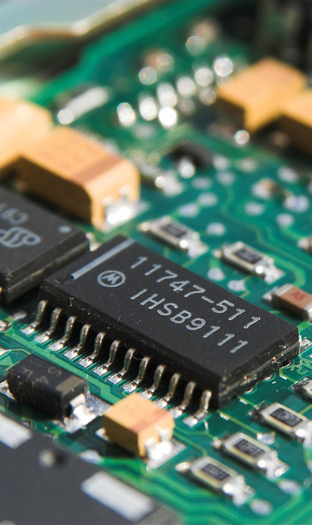
Introduction
Smart Helmet is designed with the purpose of preventing road accidents.
The various sensors present in the smart helmet each have a specific purpose for preventing accidents.
The main aim of our project is to build a safety system to reduce the probability of two-wheeler accidents.
As we see many accidents in the day to day life due to alcohol consumption so we are trying to implement alcohol sensors within the helmet.

Slide 5
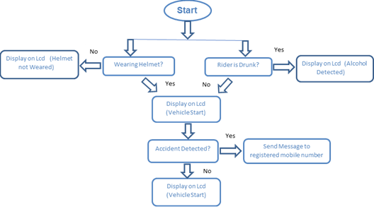
Flow Chart

Slide 6
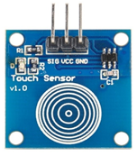
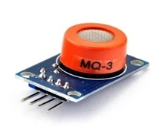
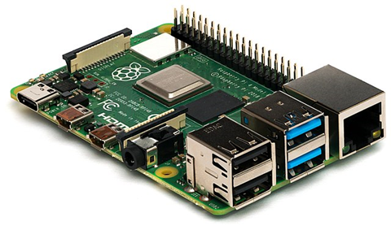

Components Used
RASPBERRY PI
TOUCH SENSOR
MQ3 GAS SENSOR
USED FOR HELMET DETECTION
USED FOR ALCOHOL DETECTION

Slide 7
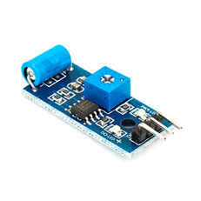
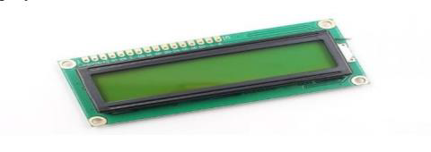
Components Used
LCD
VIBRATION SENSOR
USED FOR DISPLAYING OUTPUT.
USED FOR ACCIDENT DETECTION

Slide 8

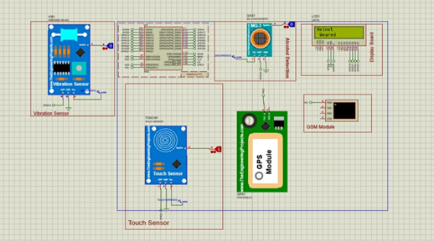
Experimental Setup

Slide 9
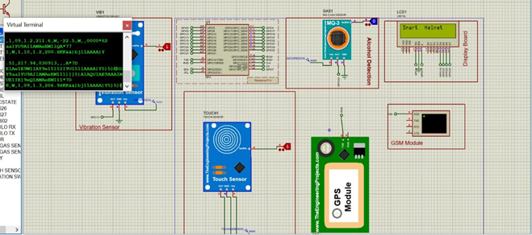
Experimental Setup

Slide 10
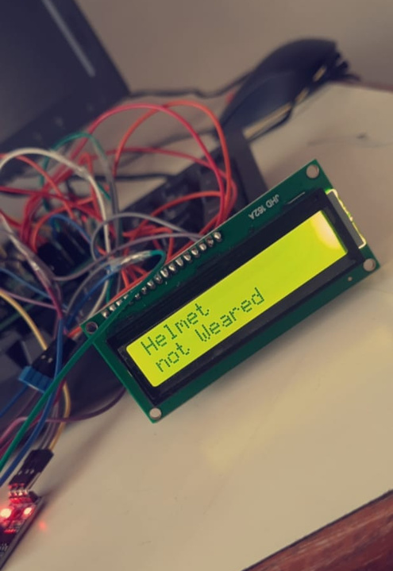
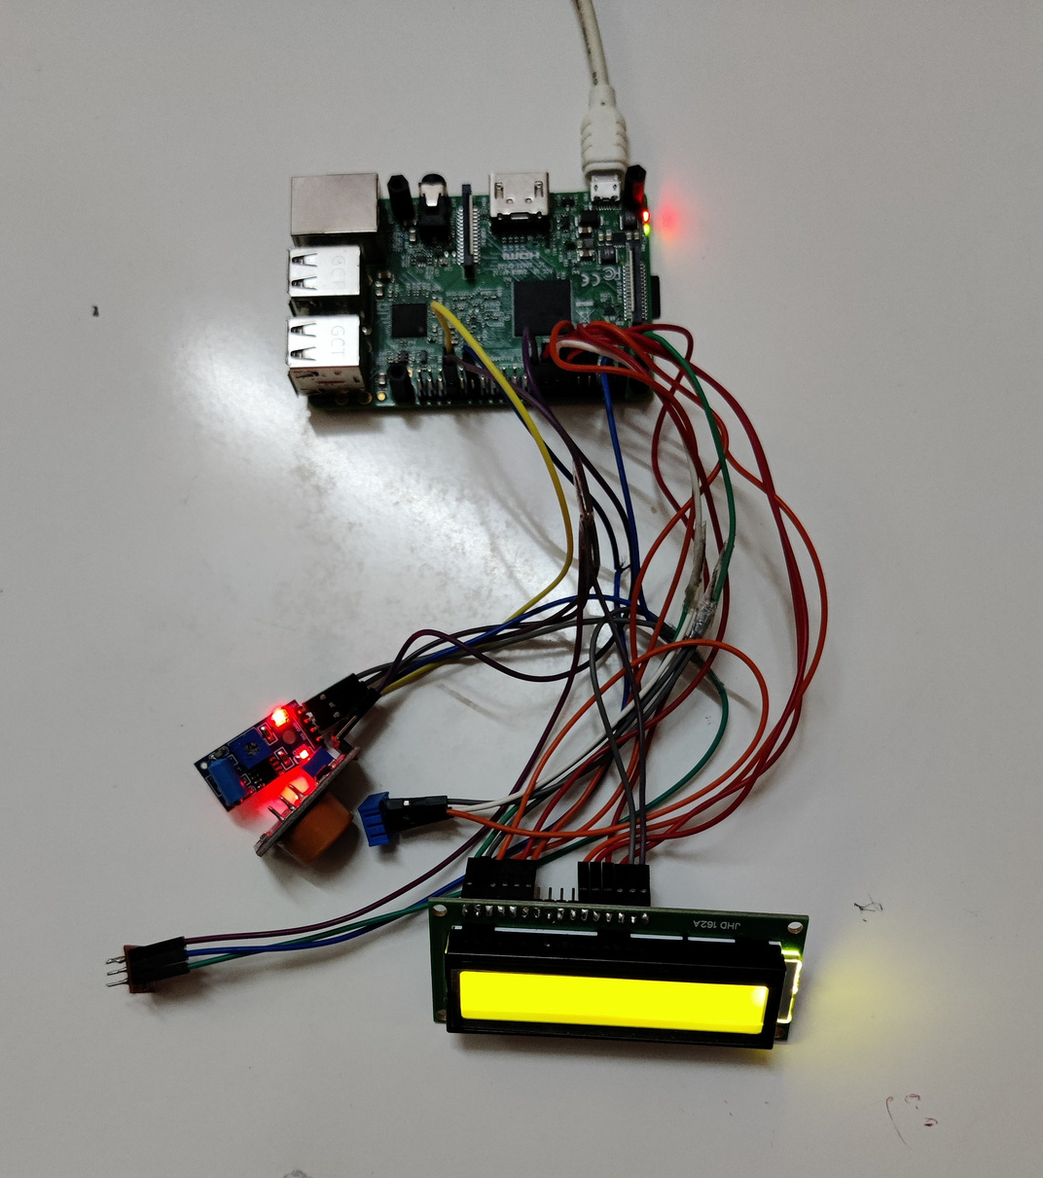
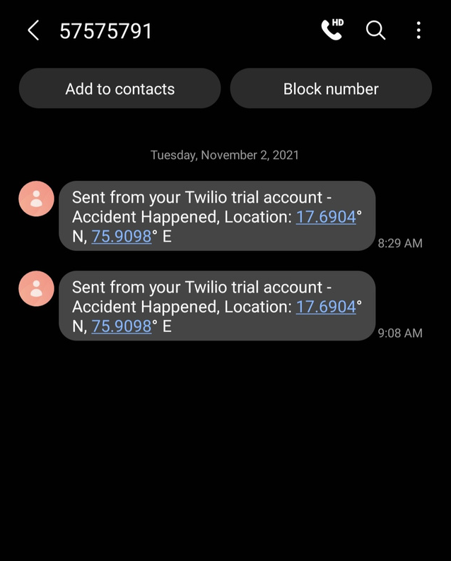
Output

Slide 11
In the smart helmet, the Raspberry Pi which controls all of the other input modules and output systems.
The MQ3 Gas Sensor is used for alcohol detection which prevents drunk driving. If any alcohol is detected, then message will be displayed on LCD (Alcohol Detected).
Working Principle
The touch sensor is used for helmet detection. If the driver is trying to ride the bike without wearing the helmet, then message will be displayed on LCD (Helmet Not Weared).
The vibration sensor is for accident detection and reporting. The vibration sensor detects if any accident has occurred. If the vibration sensor detects any accidents, the Twilio API service transmits the current location of the bike rider and then sends the location to the registered mobile number.

Slide 12
Advantages
Detection of accident in remote area can be easily detected and medical services provided in short time.
It will reduce the probability of accidents by simply avoiding drunken drive by using alcohol detector
Decrease in death rates due to head injuries.
Provide wireless connection security
Security system for motorcycles.

Slide 13
Applications
It can be used in real time safety system.
This safety system technology can further be enhanced in car or another vehicle by replacing the helmet with seat belt.
We can implement the whole circuit into small VLSI chip that can be embedded into the helmet and bike unit.
It can be designed for less power consuming safety system.

Slide 14
Future Scope
Further improvements can be done such as adding obstacle detection in fog using infrared cameras.
This safety system technology can further be enhanced in car or another vehicle by replacing the helmet with seat belt.
We control the speed of a bike depending on the road conditions using remote keyless system method
with respect to RF transmitter-receiver.
It can be used in real time safety system. We can implement the whole circuit into small module later.

Slide 15
Conclusion
The developed project efficiently ensures:
Rider is wearing helmet throughout the ride.
Rider should not be under the influence of alcohol.
Accident detection.
By implementing this project, a safe two-wheeler journey is possible which would decrease the head injuries during accidents and also reduce the accident rate due to driving bike after consuming alcohol.
The helmet can be beneficial for the rider in case of an accident to prevent fatal injuries.

Slide 16
ThankYou...!!

